Slide 1
Python
Day #3

Slide 2
Agenda
Object Oriented Programming
Classes and Objects Review
Inheritance
Polymorphism
Special Methods
Class and Instance Variables
File IO
Working with CSV Files, Excel Files
Pickle and Shelve
String format function
Case Study

Slide 3
Agenda
Networking programming using the socket module
Creating the Server
Creating the Client
Establishing connection
Developing network applications
Multi-threading using the threading module
Synchronizing Threads
Queues and Semaphores
Logging in Python

Slide 4
Files
Traditional definition: A computer file is a resource for storing information, which is available to a computer program and is usually based on some kind of durable storage
In Python, these files can be accessed using the file object discussed in the next few slides
File objects can be used to access not only normal disk files, but also any other type of "file" that uses that abstraction
Notes:
Devices are accessed as files in linux. (confirm it)

Slide 5
Opening a File
To open a file use the open() or file() functions
Syntax:
file_object = open(file_name [, access_mode][, buffering])
file_name: The file_name argument is a string value that contains the name of the file that you want to access.
access_mode: The access_mode determines the mode in which the file has to be opened, i.e., read, write, append, etc.
buffering: If the buffering value is set to 0, no buffering takes place. If the buffering value is 1, line buffering is performed while accessing a file. If you specify the buffering value as an integer greater than 1, then buffering action is performed with the indicated buffer size. If negative, the buffer size is the system default (default behavior).

Slide 6
Closing a File
The close() method of a file object flushes any unwritten information and closes the file object, after which no more writing can be done
Python automatically closes a file when the reference object of a file is reassigned to another file
It is a good practice to use the close() method to close a file
Syntax:
file_object.close()

Slide 7
Built-in Methods: Input
The read() method is used to read bytes directly into a string, reading at most the number of bytes indicated
Syntax: file_object.read([size])
The readline() method reads one line of the open file (reads all bytes until a line-terminating character like NEWLINE is encountered)
Syntax: file_object.readline([size])
The readlines() reads all (remaining) lines and returns them as a list of strings
Syntax: file_object.readlines([sizeint])
Notes:
Reads at most size bytes from the file (less if the read hits EOF before obtaining size bytes).
Reads one entire line from the file. A trailing newline character is kept in the string. Like read(), there is also an optional size option, which, if not provided, defaults to -1, meaning read until the line-ending characters (or EOF) are found. If present, it is possible that an incomplete line is returned if it exceeds size bytes.
Reads until EOF using readline() and return a list containing the lines. If the optional sizehint argument is present, instead of reading up to EOF, whole lines totalling approximately sizehint bytes (possibly after rounding up to an internal buffer size) are read.

Slide 8
Built-in Methods: Output
The write() takes a string that can consist of one or more lines of text data or a block of bytes and writes the data to the file
Syntax: file_object.write(str)
The writelines() takes a string that can consist of one or more lines of text data or a block of bytes and writes the data to the file
Syntax: file_object.writelines(sequence)

Slide 9
Working with CSV Files
A comma-separated values (CSV) file stores tabular data (numbers and text) in plain text
Each line of the file is a data record. Each record consists of one or more fields, separated by commas
csv module is used to work with csv files
Fundamental functions:
csv.reader()
csv.writer()
csv.register_dialect()
csv.get_dialect()
csv.DictReader()
csv.DictWriter()
csv.Sniffer()
Refer: https://docs.python.org/2/library/csv.html

Slide 10
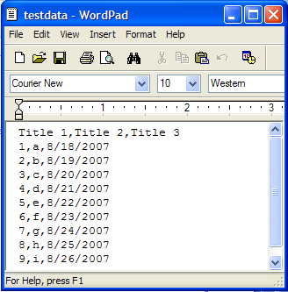
Reading CSV
import csv
import sys
f = open(r'E:\Python27\mindful_examples\csv\testdata.csv', 'r')
reader = csv.reader(f)
for row in reader:
print row
f.close()
========= RESTART: E:/Python27/mindful_examples/csv/testdata_read.py =========
['Title 1', 'Title 2', 'Title 3']
['1', 'a', '8/18/2007']
['2', 'b', '8/19/2007']
['3', 'c', '8/20/2007']
['4', 'd', '8/21/2007']
['5', 'e', '8/22/2007']
['6', 'f', '8/23/2007']
['7', 'g', '8/24/2007']
['8', 'h', '8/25/2007']
['9', 'i', '8/26/2007']

Slide 11
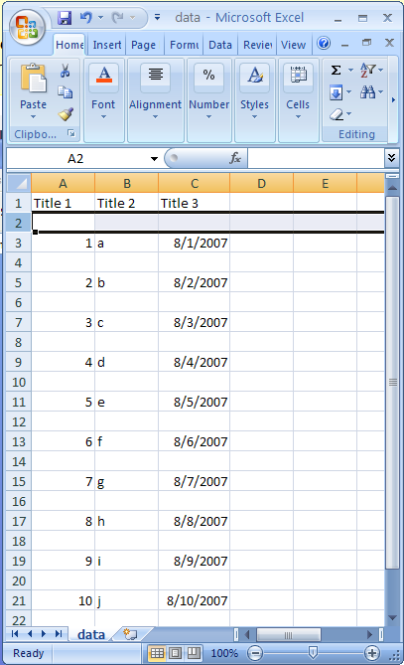
Writing CSV
import csv
import sys
f = open(r'E:\Python27\mindful_examples\csv\data.csv', 'wt')
writer = csv.writer(f, quoting=csv.QUOTE_NONNUMERIC)
writer.writerow( ('Title 1', 'Title 2', 'Title 3') )
for i in range(10):
writer.writerow( (i+1, chr(ord('a') + i), '08/%02d/07' % (i+1)) )
f.close()
print open(r'E:\Python27\mindful_examples\csv\data.csv', 'rt').read()
>>>
"Title 1","Title 2","Title 3"
1,"a","08/01/07"
2,"b","08/02/07"
3,"c","08/03/07"
4,"d","08/04/07"
5,"e","08/05/07"
6,"f","08/06/07"
7,"g","08/07/07"
8,"h","08/08/07"
9,"i","08/09/07"
10,"j","08/10/07"

Slide 12
Pickle
Text files are convenient because you can read and manipulate them with any text editor, but they’re limited to storing a series of characters.
Sometimes you may want to store more complex information, like a list or a dictionary, for example
Pickling means to preserve—and that’s just what it means in Python
You can pickle a complex piece of data, like a list or dictionary, and save it in its entirety to a file
The pickle module allows you to pickle and store more complex data in a file.

Slide 13
What Can Be Pickled and Unpickled?
The following types can be pickled:
None, True, and False
integers, long integers, floating point numbers, complex numbers
normal and Unicode strings
tuples, lists, sets, and dictionaries containing only picklable objects
functions defined at the top level of a module
built-in functions defined at the top level of a module
classes that are defined at the top level of a module
instances of such classes whose __dict__ or the result of calling __getstate__() is picklable

Slide 14
Shelve
The shelve module allows you to store and randomly access pickled objects in a file

Slide 15
Pickling and Shelving Functions
Function | Purpose
pickle.dump(obj, file_handle) | Write a pickled representation of obj to the open file object file
pickle.load(file) | Read a string from the open file object file and interpret it as a pickle data stream, reconstructing and returning the original object hierarchy
shelve.open(filename, flag='c', protocol=None, writeback=False) | Open a persistent dictionary. The filename specified is the base filename for the underlying database
Shelf.sync() | Write back all entries in the cache if the shelf was opened with writeback set to True
Shelf.close() | Synchronize and close the persistent dict object.
Refer:
https://docs.python.org/2/library/shelve.html
https://docs.python.org/2/library/pickle.html

Slide 16
Pickle: Example
# pickle_demo.py: Demonstrates pickling data
import pickle
print("Pickling lists")
variety = ["sweet", "hot", "dill"]
shape = ["whole", "spear", "chip"]
brand = ["Claussen", "Heinz", "Vlassic"]
f = open("pickles1.dat", "wb")
pickle.dump(variety, f)
pickle.dump(shape, f)
pickle.dump(brand, f)
f.close()
print("\nUnpickling lists")
f = open("pickles1.dat", "rb")
variety = pickle.load(f)
shape = pickle.load(f)
brand = pickle.load(f)
print(variety)
print(shape)
print(brand)
f.close()

Slide 17
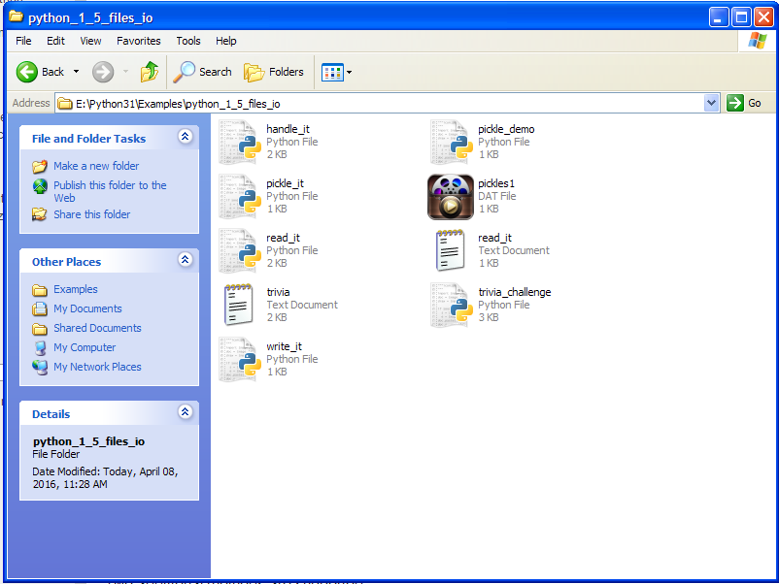
Output
>>>
Pickling lists
Unpickling lists
['sweet', 'hot', 'dill']
['whole', 'spear', 'chip']
['Claussen', 'Heinz', 'Vlassic']
pickles1.dat

Slide 18
Shelve: Example
# shelve_demo.py: Demonstrates shelving data
import shelve
print("\nShelving lists")
s = shelve.open("pickles2.dat")
s["variety"] = ["sweet", "hot", "dill"]
s["shape"] = ["whole", "spear", "chip"]
s["brand"] = ["Claussen", "Heinz", "Vlassic"]
s.sync() # make sure data is written
print("\nRetrieving lists from a shelved file:")
print("brand -", s["brand"])
print("shape -", s["shape"])
print("variety -", s["variety"])
s.close()
input("\n\nPress the enter key to exit.")

Slide 19
Output
>>>
Shelving lists
Retrieving lists from a shelved file:
brand - ['Claussen', 'Heinz', 'Vlassic']
shape - ['whole', 'spear', 'chip']
variety - ['sweet', 'hot', 'dill']
Press the enter key to exit.

Slide 20
The string format function
The format() method formats the specified value(s) and insert them inside the string's placeholder.
The placeholder is defined using curly brackets: {}. Read more about the placeholders in the Placeholder section below.
The format() method returns the formatted string.
Syntax
string.format(value1, value2...)

Slide 21
Case Study
Let’s check the code

Slide 22
Introduction
Internet happens to be the one of the primary application areas of Python programming language
Python standard library has wide support for network protocols, data encoding/decoding and other things you need to make it work
Writing network programs in Python tends to be substantially easier that C/C++
Notes:
Exercise: Google: Companies using python

Slide 23

The Challenge
Communication between computers
It’s just sending and receiving bits
But how?

Slide 24
Two Main Issues
Addressing
Specifying a remote computer and service
Data Transport
Moving bits back and forth

Slide 25

Network Addressing
Machines have a host name and IP address
Programs/services have port numbers
foo.bar.com
205.172.12.4
www.python.org
82.94.237.218
Network
Port 4521
Port 80

Slide 26
Standard Ports
Ports for common services are pre-assigned
21 FTP
22 SSH
23 Telnet
25 SMTP (Mail)
80 HTTP (Web)
110 POP3 (Mail)
119 NNTP (News)
443 HTTPS (web)
Other port numbers may just be randomly assigned to programs by the operating system

Slide 27
Client/Server Concept
Each endpoint is a running program
Servers wait for incoming connections and provide a service (e.g., web, mail, etc.)
Clients make connections to servers
Client
Server
www.python.org
82.94.237.218
Browser
Web
Port 80

Slide 28
Request/Response Cycle
Most network programs use a request/response model based on messages
Client sends a request message (e.g., HTTP)
GET /index.html HTTP/1.0
Server sends back a response message
HTTP/1.0 200 OK
Content-type: text/html
Content-length: 48823
<HTML>
...
The exact format depends on the application

Slide 29
Sockets
Programming abstraction for network code
Socket: A communication endpoint
Supported by socket library module
Allows connections to be made and data to be transmitted in either direction
Socket
Socket
Network

Slide 30
Socket Basics
To create a socket
socket.AF_INET Internet protocol (IPv4)
socket.AF_INET6 Internet protocol (IPv6)
Socket types
socket.SOCK_STREAM Connection based stream (TCP)
socket.SOCK_DGRAM Datagrams (UDP)
Example
from socket import *
s = socket(AF_INET, SOCK_STREAM)

Slide 31
Socket Types
Almost all code will use one of the following:
from socket import *
s = socket(AF_INET, SOCK_STREAM)
s = socket(AF_INET, SOCK_DGRAM)
Most common case: TCP Connection
s = socket(AF_INET, SOCK_STREAM)

Slide 32
Using a Socket
Creating a socket is only the first step
s = socket(AF_INET, SOCK_STREAM)
Further use depends on application
Server
Listen for incoming connections
Client
Make an outgoing connection

Slide 33
TCP Client
How to make an outgoing connection
from socket import *
s = socket(AF_INET,SOCK_STREAM)
s.connect(("www.python.org",80)) # Connect
s.send("GET /index.html HTTP/1.0\n\n") # Send request
data = s.recv(10000) # Get response
s.close()
s.connect(addr) makes a connection
s.connect(("www.python.org",80))
Once connected, use send(), recv() to transmit and receive data
close() shuts down the connection

Slide 34
Server Implementation
Network servers are a bit more tricky
Must listen for incoming connections on an well-known port number
Typically run forever in a server-loop
May have to service multiple clients

Slide 35
TCP Server
A simple server
from socket import *
s = socket(AF_INET,SOCK_STREAM)
s.bind(("",9000))
s.listen(5)
while True:
c,a = s.accept()
print "Received connection from", a
c.send("Hello %s\n" % a[0])
c.close()
Send a message back to a client
% telnet localhost 9000
Connected to localhost.
Escape character is '^]'.
Hello 127.0.0.1
Connection closed by foreign host.
Server Message

Slide 36
TCP Server
Client socket and address
from socket import *
s = socket(AF_INET,SOCK_STREAM)
s.bind(("",9000))
s.listen(5)
while True:
c,a = s.accept()
print "Received connection from", a
c.send("Hello %s\n" % a[0])
c.close()
c,a = s.accept()
Accept returns a pair:
(client_socket, addr)
("104.23.11.4",27743)
This is a network /port address of the client that is connected
<socket._socketobject object at 0x3be30>
This is a new socket that is used for data

Slide 37
Multi-threading
Running multiple threads is equivalent to running several programs in parallel
A thread has a beginning, execution sequence and a conclusion
Multiple threads within a process share the same data space with the main thread and can therefore share information or communicate with each other more easily than if they were separate processes.
Threads have lesser memory overhead than processes

Slide 38
Threading Module
To create a thread using threading module
Define a new subclass of the Thread class.
Override the __init__(self [,args]) method to add additional arguments.
Then, override the run(self [,args]) method to implement what the thread should do when started.

Slide 39
Example
class myThread (threading.Thread):
def __init__(self, threadID, name, counter):
threading.Thread.__init__(self)
self.threadID = threadID
self.name = name
self.counter = counter
def run(self):
print "Starting " + self.name
print_time(self.name, self.counter, 5)
print "Exiting " + self.name
def print_time(threadName, counter, delay):
while counter:
if exitFlag:
threadName.exit()
time.sleep(delay)
print "%s: %s" % (threadName, time.ctime(time.time()))
counter -= 1
# Create new threads
thread1 = myThread(1, "Thread-1", 1)
thread2 = myThread(2, "Thread-2", 2)
# Start new Threads
thread1.start()
thread2.start()

Slide 40
Supporting Functions
run(): The run() method is the entry point for a thread.
start(): The start() method starts a thread by calling the run method.
join([time]): The join() waits for threads to terminate.
isAlive(): The isAlive() method checks whether a thread is still executing.
getName(): The getName() method returns the name of a thread.
setName(): The setName() method sets the name of a thread.

Slide 41
Synchronizing Threads
The threading module provided with Python includes a simple-to-implement locking mechanism that allows you to synchronize threads.
A new lock is created by calling the Lock() method, which returns the new lock.
The acquire() method of the new lock object is used to force threads to run synchronously
The release() method of the new lock object is used to release the lock when it is no longer required

Slide 42
Example
import threading
import time
class myThread (threading.Thread):
def __init__(self, threadID, name, counter):
threading.Thread.__init__(self)
self.threadID = threadID
self.name = name
self.counter = counter
def run(self):
print "Starting " + self.name
# Get lock to synchronize threads
threadLock.acquire()
print_time(self.name, self.counter, 3)
# Free lock to release next thread
threadLock.release()
def print_time(threadName, delay, counter):
while counter:
time.sleep(delay)
print "%s: %s" % (threadName, time.ctime(time.time()))
counter -= 1
threadLock = threading.Lock()
threads = []

Slide 43
Example
# Create new threads
thread1 = myThread(1, "Thread-1", 1)
thread2 = myThread(2, "Thread-2", 2)
# Start new Threads
thread1.start()
thread2.start()
# Add threads to thread list
threads.append(thread1)
threads.append(thread2)
# Wait for all threads to complete
for t in threads:
t.join()
print "Exiting Main Thread"

Slide 44
Queues
The Queue module allows you to create a new queue object that can hold a specific number of items. There are following methods to control the Queue −
get(): The get() removes and returns an item from the queue.
put(): The put adds item to a queue.
qsize() : The qsize() returns the number of items that are currently in the queue.
empty(): The empty( ) returns True if queue is empty; otherwise, False.
full(): the full() returns True if queue is full; otherwise, False.

Slide 45
Example
import Queue, threading, time
exitFlag = 0
class myThread (threading.Thread):
def __init__(self, threadID, name, q):
threading.Thread.__init__(self)
self.threadID = threadID
self.name = name
self.q = q
def run(self):
print "Starting " + self.name
process_data(self.name, self.q)
print "Exiting " + self.name
def process_data(threadName, q):
while not exitFlag:
queueLock.acquire()
if not workQueue.empty():
data = q.get()
queueLock.release()
print "%s processing %s" % (threadName, data)
else:
queueLock.release()
time.sleep(1)
threadList = ["Thread-1", "Thread-2", "Thread-3"]
nameList = ["One", "Two", "Three", "Four", "Five"]
queueLock = threading.Lock()
workQueue = Queue.Queue(10)

Slide 46
Example
threads = []
threadID = 1
# Create new threads
for tName in threadList:
thread = myThread(threadID, tName, workQueue)
thread.start()
threads.append(thread)
threadID += 1
# Fill the queue
queueLock.acquire()
for word in nameList:
workQueue.put(word)
queueLock.release()
# Wait for queue to empty
while not workQueue.empty():
pass
# Notify threads it's time to exit
exitFlag = 1
# Wait for all threads to complete
for t in threads:
t.join()

Slide 47
Semaphores
In programming, especially in Unix systems, semaphores are a technique for coordinating or synchronizing activities in which multiple processes compete for the same operating system resources.

Slide 48
Example
import threading
sem = threading.Semaphore()
def fun1():
while True:
sem.acquire()
print(1)
sem.release()
def fun2():
while True:
sem.acquire()
print(2)
sem.release()
t = threading.Thread(target = fun1)
t.start()
t2 = threading.Thread(target = fun2)
t2.start()

